Slide 1

Space Vision 2018
November 1st-4th
San Diego, California

Slide 2

Build Space Better
Through collaboration we can achieve greater heights, improve on past accomplishments, and shape the future of space exploration.
Hosted by UCSD SEDS
Well known as the Best University Rocketry Organization in the US

Slide 3
Why are we going?
Network and connect with professionals in the aerospace industry
By attending Space Vision 2018: Build Space Better, we hope to bring back:
An immense amount of connections to further our knowledge in rocketry and better organizational management
Greater our knowledge in the importance of community outreach using rocketry (which is a very exciting gateway for students to joining STEM fields)
Obtain ideas on how to engage the community more with rocket launches, workshops etc.
Meet the majority of other SEDS members around the country and make connections
Learn how the top rocket engineering teams in the country manage and innovate

Slide 4
Budget
$85 Entrance to the Conference
Round Trip Flight for $430.00
Room for 3 nights is $100 per person
-$67 From SAFC*
Will attempt to reimbuse $2-300 per person from SEDS fund over the year
16 students coming
TOTAL
$615 up front
-$67reimbursement
$548 per member
Overall club funding is ongoing, but it is expected that the funding will not support our operational costs and Space Vision reimbursement.

Slide 5
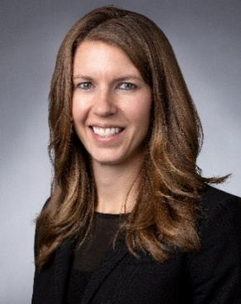
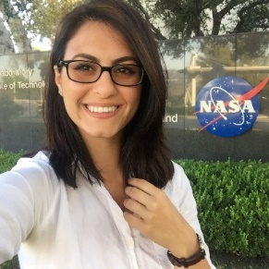
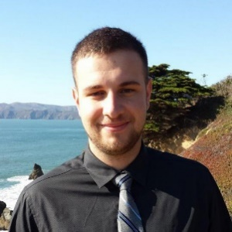
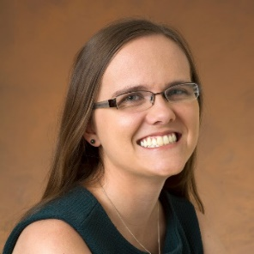
What goes on?
There are various workshops throughout regarding:
Liquid Propulsion Design
How to run an Engineering Organization
Community Engagement
How to Network as a 21st Century Engineer
Danielle Richey
Advanced Programs - Lockheed Martin Space
Diana Alsindy
Propulsion Engineer - Virgin Orbit
Kyle Adriany
Chief Technology Officer - Additive Rocket Corporation (ARC)
Keri Bean
Mission Operations Engineer - NASA Jet Propulsion Laboratory

Slide 6
UNH SEDS Outreach
2018-2019 Academic Year
Durham, NH and Surrounding Areas

Slide 7
What is in the works for local grade schools
K-12 Low-Power Rocket Building Techniques Workshop with local grade schools
Durham
Portsmouth
Dover
Partner with STEMbassadors to travel to NH schools and run various space-themed activities running 15 minutes each
Phases of the Moon
Constellations
Finding Exo-Planets
Out of this world rocks (Astronaut Glove)
With the help of Space Vision and SAFC financial support, we will have:
The expertise, and
the monetary backing
to touch the minds of young students around NH to get excited for the future of space exploration and the pursuit of science.

Slide 8
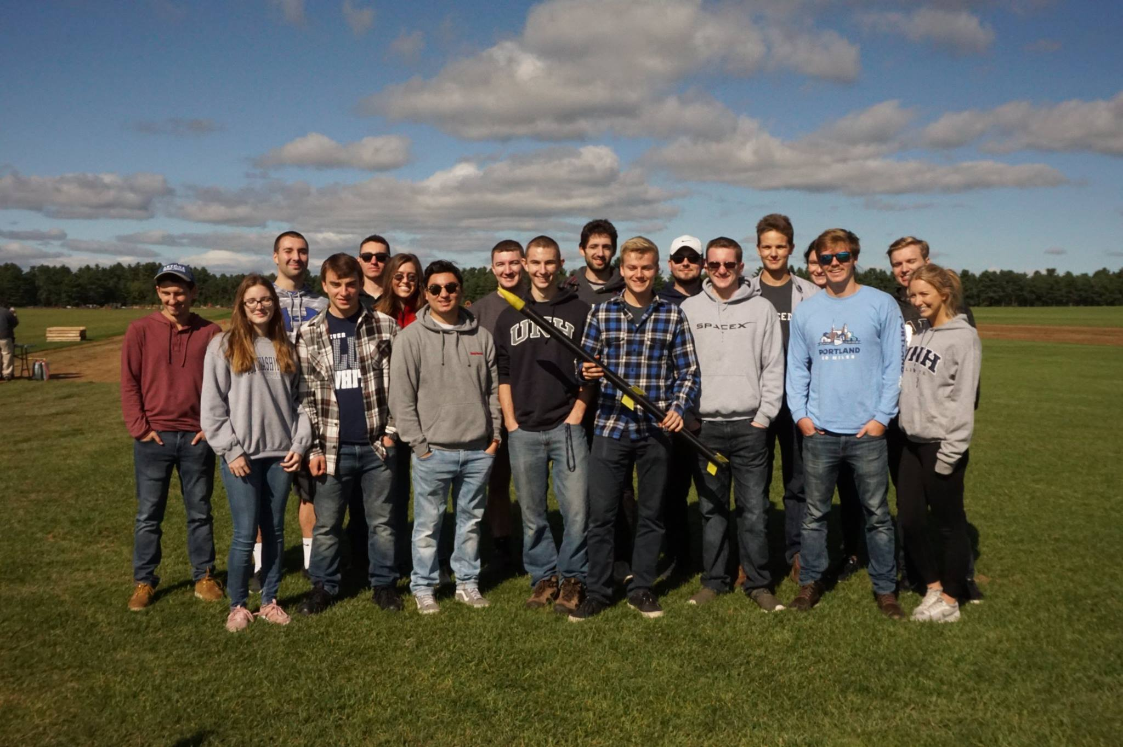
Local Rocket Launches
Last year, we converted a UNH-owned launch field to a low-power rocket launch site. Over the year, we expect to hold several launches that are open to the UNH community and public that can become a popular Saturday activity for many
Our larger rockets and homemade engines will launch from South Berwick, ME that has a FAA flight waiver of 10,000 feet on specific NAR launch days. With an increase in student awareness, and we can create an outreach event that not only attracts the public to become excited for space exploration, but increase the popularity of high-power rocketry

Slide 9
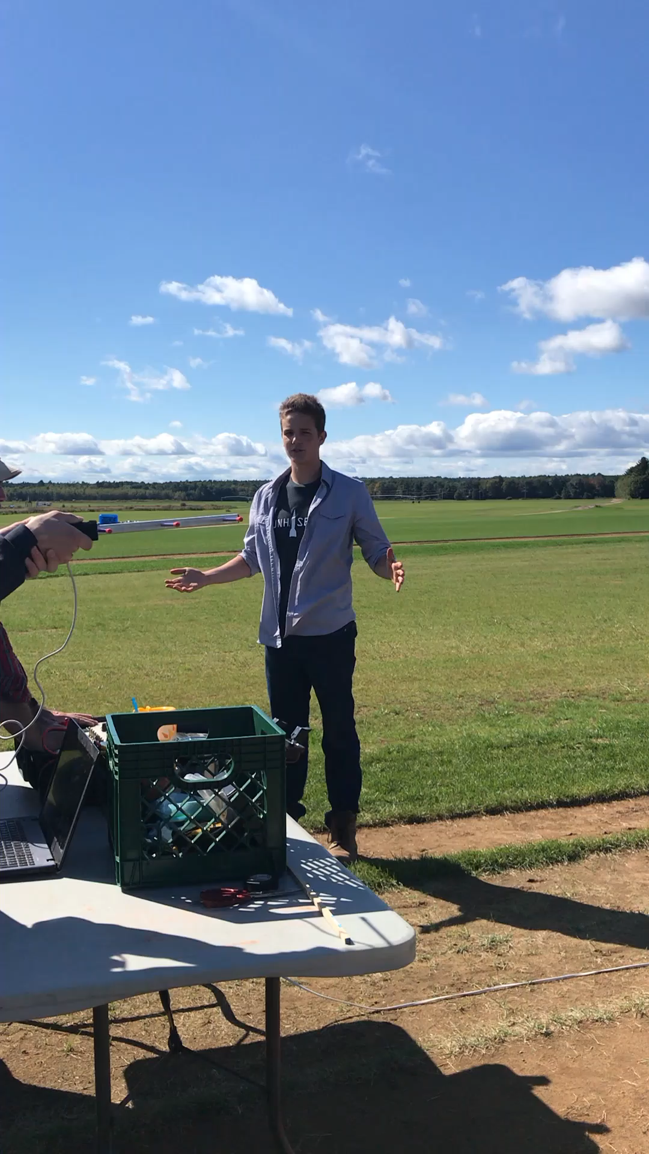
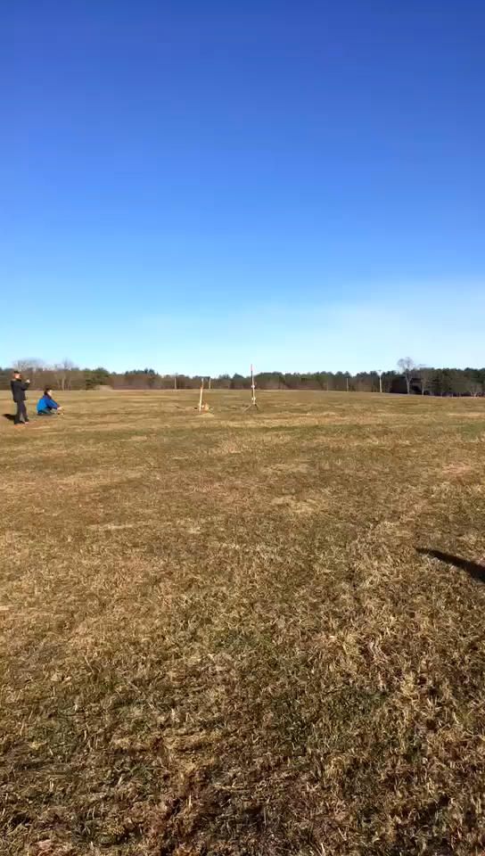
Some Videos…
Our SEDS Carbon Fiber Competition Rocket Launch in late September 2018
First Multi-Stage Rocket Launch at the UNH field

